Slide 1
Gamma: Our annoying friend

Slide 2
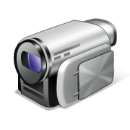


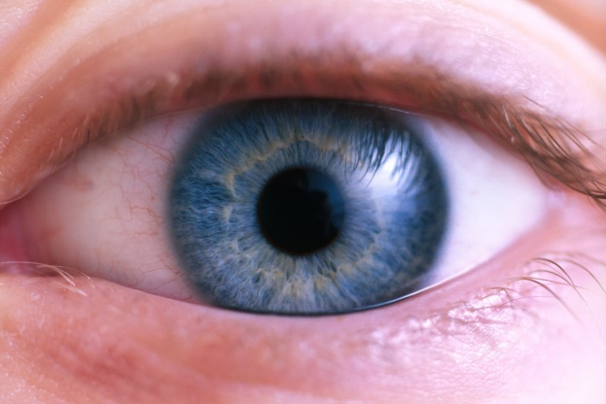

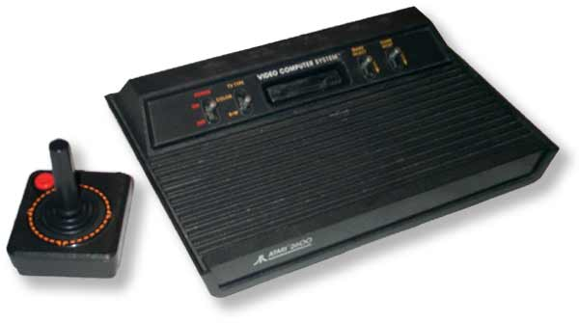
Light through the pipeline
Light captured digitally or analog by camera
… saved digitally as file on PC, then edited…
… burned to digital media …
… loaded and processed by video software…
… transmitted, decoded, displayed on TV …
… perceived by the human eye

Slide 3
The three “Bigs”
The Big Lie
Light in = light out
The Big Coincidence
Light in ~ light out
The Big Deal
Who cares?
Notes:
The Big Lie: The arrows in the preceding page represent physical quantities being transmitted undistorted.
The Big Coincidence: The distortions sort of cancel out.
The Big Deal: The distortions make things look much worse than they have to, if you’re not careful

Slide 4
Linear space
Linear light means number of photons
Actual units: Candela
  Power per direction per solid angle
  Restricted to visible wavelengths
Physics calculations must be linear to be accurate:
  Lighting
  Filtering
  Alpha-blending
  Multi-sampling/Super-sampling

Slide 5
Gamma space
Perceptual units
How different do two brightnesses appear to the human eye?
Notes:
Anecdote: All sorts of things have an associated “gamma”. For instance, football pointspreads. Suppose I pick the Steelers by 11 on Sunday, and they win by 1. I’m 10 points off. Now suppose I pick the Steelers by 30 and they win by 40. I’m still 10 points off. But in some very intuitive sense, the 10 points in the first case means more than the 10 points in the second case. The same is true of equal steps in brightness.

Slide 6

Gamma measured
From experiments, gamma space is related to linear space by a power law
I_{Perceived} ~ I_{Linear}^{0.4}
We distinguish dark colors much better than bright colors

Slide 7
The big coincidence
Coincidentally, the response curve of a standard TV is almost the inverse
I ~ V^{2.5}
Newer TVs fake this
We can use perceptual units for signal!

Slide 8
Actual Gamma
The exponent (e.g. 2.5) is called Gamma
Several standards: sRGB, TV Rec. 709, hardware/software internal
These intentionally leave a bias: encode at gamma 2.2-2.4, display at gamma 2.5
Because viewing conditions tend to be brighter than recording conditions
You can adjust gamma --- called ‘contrast’ on TV dials/menus

Slide 9
Gamma in graphics
Engineers have two conflicting objectives:
  Get the physics right --- need linear space
  Retain visual precision --- need gamma space
Implies conversion operations in pipeline
I’=I^{0.4}
I=I’^{2.5}
Linear source I
Physical calculation
Constrained
bandwidth

Slide 10
What if I don’t want to?
Can I avoid gamma?
  Not unless you invent your own monitor
Can I ignore gamma?
  Yes, if you do no physical calculation
  Or if you don’t care
  But you leave a lot of available precision unused
  How much, you ask?

Slide 11


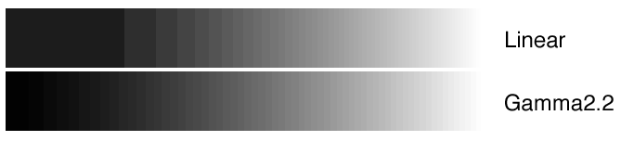
Banding

Slide 12
How many bits are enough?
Rule of thumb: We distinguish intensities which are more than about 1% apart
Rule of thumb: We can see an intensity range of about 100:1
Brighter or darker than this, we compensate by pupils contracting or dilating (change of exposure)

Slide 13
How many bits are enough?
To represent all perceptible intensities:
Linear space:
  ~10,000 values (1.00, 1.01, 1.02, … 100.00)
  13-14 bits (2¹³ = 8192; 2¹⁴ = 16,384)
  When 16 bits is standard, we can stop worrying…
Gamma space:
  ~463 values (1.00, 1.01, 1.01², … 1.01⁴⁶³~100)
  8-9 bits (2⁸ = 256; 2⁹ = 512)
  Coincidentally 8 bits is how many we have today!

Slide 14
How many bits are enough?
Without gamma, how bad do things get?
Linear space:
  8 bits (2⁸ = 256)
  256 values in steps of 99/255
  (1.00, 1.39, 1.78, …
  … 98.84, 99.22, 99.61, 100.00)
  The first two values skip around 30 distinct perceptible steps!
  The final three values are indistinguishable to the eye!

Slide 15
Getting gamma wrong
What if I mix gamma and linear up?
If you use gamma values as linear values, or vice-versa…
Lighting errors --- linear math done on gamma values tends to come out darker
Roping --- filtering in gamma space makes solid lines appear dotted
Color shifting --- bias toward primary R, G, B
… and many more along these lines

Slide 16
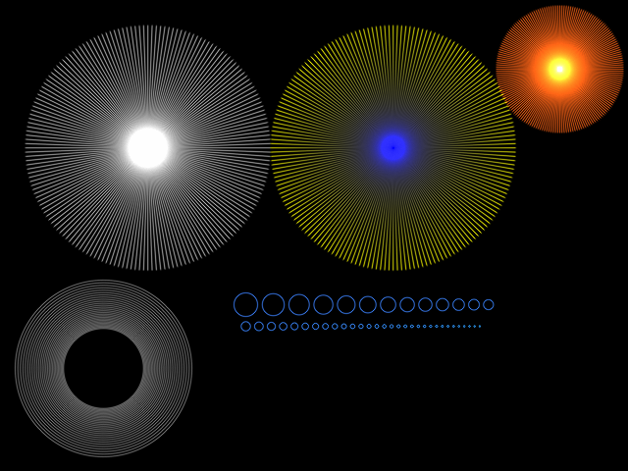
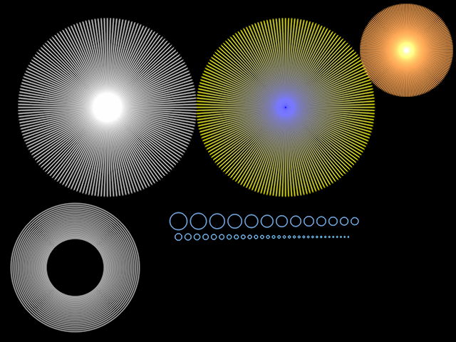
Moire
Gamma-correct downsampling
Gamma-incorrect downsampling
sRGB = 1.0
Linear = 1.0^{2.2} = 1.0
Linear = 1.0
Linear = 0.5
sRGB = 0.5
Linear = 0.5^{2.2} = 0.2
Two half-pixels equal one whole
Two half-pixels darker than one whole

Slide 17
Getting gamma right
Know the intended interpretation
Are values meant to be linear or gamma?
Where do conversions happen?
What does the hardware expect?
Sad truth:
  Multiple errors are often okay (cancel out)
  Single error is always bad

Slide 18
Tracking gamma conversions
Real world (Linear)
Input data (sRGB)
Texture fetch (Linear)
Render target (sRGB/Linear)
Front buffer (sRGB/Linear)
Output signal (sRGB/Rec. 709)
Monitor emission (Linear)
Multipass

Slide 19
Real world → Input data
Cameras have gamma
Art packages have gamma (Photoshop profile)
Q: What do I have to do?
A: Assume that a texture from an artist, from a camera, from the web, is sRGB

Slide 20
Input data → texture fetch
Modern GPUs perform gamma correction in hardware upon read
Order of operations matters (see below)
Q: What do I have to do?
A: Label color texture as sRGB
A: Label non-color texture as linear
Decompress
(sRGB)
Degamma
Texture cache (Linear)
Filter
(Linear)
VRAM (sRGB)
Shader (Linear)
Notes:
Decompression should take place in sRGB, because compression is a perceptual method --- want to minimize error in gamma space.
Filtering should take place in Linear, because it is a physical method --- approximate incoming intensity at an intermediate point.

Slide 21
Texture fetch → render target
Modern GPUs perform gamma correction in hardware upon write
Again, order of operations matters (below)
Q: What do I have to do?
A: Label render target as sRGB
A: Or else use 16-bpp format
Output
Gamma
Degamma
Shader (Linear)
Alpha blend (Linear)
VRAM (sRGB)

Slide 22
Render target → front buffer
Often these are the same memory
Front buffer is read by the hardware to produce output signal
Must usually be low bit depth --- 8- or 10-bit per channel
Q: What do I have to do?
A: Label front buffer as sRGB

Slide 23
Front buffer → signal → TV
Under the hood…
PC/consoles do LOTS of image processing:
  Color-space conversion (e.g. RGB → YUV)
  Hardware up/down-scaling
  Digital-to-analog conversion (DAC)
Modern TVs do LOTS of image processing:
  Rescaling to native pixel resolution
  Second-guessing you ☺
Q: What do I have to do?
A: Pray

Slide 24
Review
Brightness can be represented two ways
  Physical (Linear)
  Perceptual (Gamma)
When bits are free these won’t matter
Until then, choose wisely…

Slide 25
References
Charles A. Poynton (2003). Digital Video and HDTV: Algorithms and Interfaces.
Free chapter of Charles Poynton, A Technical Introduction to Digital Video: Chapter 6: Gamma
Gamma correction (Wikipedia)
Stephen H. Westin Gamma correction (banding images)
Greg Ward High Dynamic Range Image Encodings (banding images)
Tomas Akenine-Möller, Eric Haines, and Naty Hoffman Real-Time Rendering (moire patterns)

Slide 26
Questions?

Slide 27
NTSC Color TV
Longtime US television analog broadcast standard
Going away in one month (?)
First nationwide NTSC color broadcast: Rose Bowl parade 1954
How to cram color into 0 bandwidth?
Not a problem in Europe due to low black & white penetration

Slide 28

USA 1953
Black & white
broadcast
Black & white
receiver
Problem 1:
Signals share same airspace
Problem 2:
Color TV owners want to see black & white shows
Problem 3:
Black & white TV owners want to see color shows
Color
broadcast
Color
receiver

Slide 29
Side effects
Field rate changed from 60 Hz to 59.94 Hz (reduced by 0.1 %)
Avoided interference between audio and color
Movie playback fails due to framerate difference: 24 Hz vs. 30 Hz
In Europe PAL playback is just sped up to 25 Hz … car chases 4% more exciting

