Slide 1
Graphics Optimization and Debugging
Bruce Dawson
XNA Developer Connection
Microsoft

Slide 2
Rendering Pipeline
CPU issues command
GPU processes command
Vertex shader
Triangle assembly
Coarse rasterization and clipping
Fine rasterization
Pixel shader
Depth/color/stencil read/compare/write (ROP)

Slide 3
Optimization Strategies
Do less work
Or, do it faster
Unless it’s happening in parallel and isn’t affecting performance
Notes:
GPUs are probably more parallel than you imagine

Slide 4
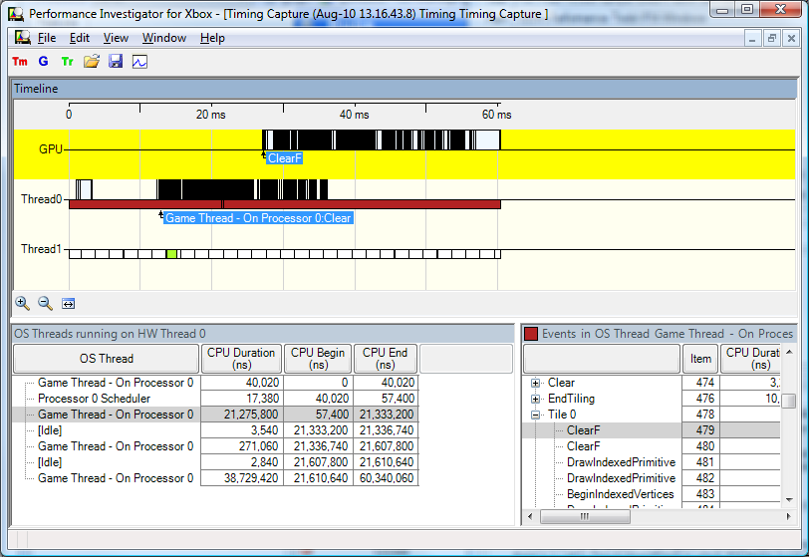
Notes:
Note the offset between when the command is issued on Thread0 and when the GPU starts processing it. This offset can be much greater because the CPU writes commands to a FIFO which the GPU reads from.
Also note that the CPU and GPU are doing work in parallel. This buffering and parallelism continues to inside the GPU with many different units working in parallel on different rendering stages.

Slide 5
CPU issues command
Reduce number of draw calls
Instancing
D3D10 allows many more options for this
Reduce amount of state changed each draw call
Avoid shader compilation and patching
Avoid creating/destroying resources during gameplay
Never* wait on results from the GPU
GPU reads command
State changes may flush GPU pipelines
* Hardly ever
Notes:
It is quite easy for a game to be bottlenecked on the CPU cost of rendering. This is fundamentally single-threaded and the same thread probably has many other tasks to do. A game may want/need to do thousands of draw calls. For each draw call there is overhead within your game and within the driver.
Sending constants down can be quite expensive. D3D10, if used intelligently, can help reduce the amount of constant data sent down, thus reducing cost. The D3D10 goal should be to send down as few constant buffers as possible, while avoiding redundant or unused data in these constant buffers.
Sorting by state can help.
Changing the contents of resources (done carefully) is cheaper than creating/destroying them when streaming in resources

Slide 6
Vertex Shader
Should be fewer vertices than pixels
Make it so
Consider LOD, clipped geometry, occluded geometry, etc.
Vertex shader may be run multiple times per object
Shadows, environment maps, etc.
Vertex power may be less than pixel power
Vertex power may subtract from pixel power
Vertex cache and post-transform cache help
Size matters
Notes:
On older graphics card the vertex and pixel processing pipelines are separate and the vertex pipeline is less powerful, so it can be a bottleneck.
On newer graphics cards (and Xbox 360) the pixel and vertex processing pipelines share ALUs, so there is huge vertex processing power, but every ALU used by vertices is stolen from pixels.
Vertex cache helps to avoid redundant memory fetches by caching 8-KB or so of raw memory.
Post-transform cache caches the last ~16 transformed vertices so that with carefully designed indexed primitives you can avoid re-transforming vertices. Use mesh optimizers to improve post-transform cache usage.
Consider vertex size, don’t waste processing, but generally it’s cheaper to do work in vertices rather than pixels.
Note that the assumption that there are fewer vertices than pixels leads to a workload guideline: any work that can be moved from the pixel shader to the vertex shader should be. Generally.

Slide 7
Triangle Assembly
Takes in three vertices, computes gradients, does stuff
Rarely a bottleneck
‘nuff said

Slide 8
Coarse Rasterization and Clipping
Discard triangles that are fully off-screen
Coarse-rasterize triangles that are within the guard band
Discarding blocks that are off-screen
Clip triangles that cross the guard band
Expensive!
Beware of triangles that project off to infinity

Slide 9
Fine Rasterization
Hi-Z/ZCULL
Shaders that don’t run are fastest
Also saves frame-buffer bandwidth
You must clear depth buffer every frame!
Early-z read/culling
Interpolating pixel shader inputs
Can be a bottleneck if you are careless
Small triangles are bad
GPUs process pixels in large batches
Notes:
Front to back is best in order to get better hi-z/zcull culling
Depth pre-pass can achieve this without sorting (increases vertex cost, may increase total cost, or not)
Hi-Z/ZCULL are typically lower resolution in all dimensions
Early-z read/culling is when the GPU reads the depth buffer before running the shader. This is more precise than hi-z/zcull culling and thus may allow more pixels to be discarded before shading. It is more expensive than hi-z/zcull which is why it is done afterwards.
hi-z/zcull and early-z optimizations only work with certain depth/alpha/stencil modes.
Too many pixel shader inputs can be a bottleneck – avoid having many inputs each only using one channel, especially if shader is simple

Slide 10
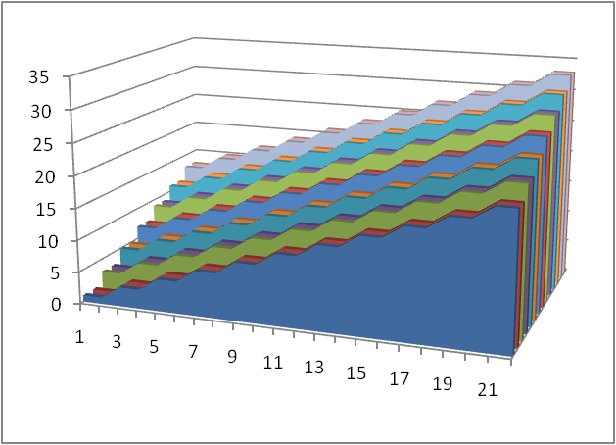
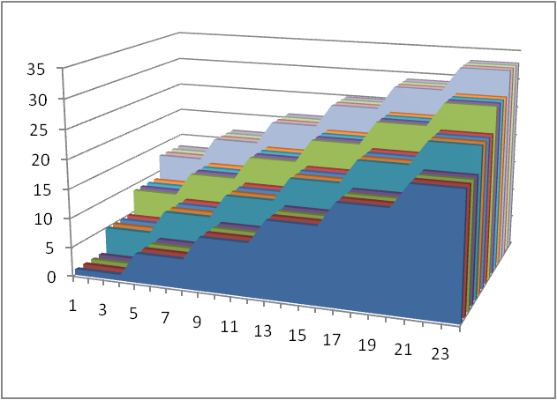
Regular Z and Hi-Z

Slide 11
Pixel Shader
Skipped for depth-only (no shader) rendering
Double speed on most hardware!
ALU operations
Texture operations
4 5D-vector ALU per TEX on AMD
10 scalar ALU per TEX on NVIDIA GeForce 8 series
Deep textures/tri-linear cost more
Notes:
Point sampling and bilinear filtering run at the same speed
Some day trilinear filtering may run at the same speed

Slide 12
Branching
GPUs process pixels in large batches
Larger batches reduce control-flow logic
But branches are a problem
2x2 blocks allow calculating gradients/LOD
So conditional texture instructions that compute LOD are moved before the branch!
Notes:
Branch coherency is important

Slide 13
Bandwidth Math
TEX rate * clockspeed * texel size = big number
Mip-map
Compress textures
Consider texture size/bandwidth
Use ALUs to replace texture lookups
Except when using texture lookups to replace ALUs

Slide 14
Hiding Latency
Threads of batches of pixels
Threads = TotalRegisters / RegistersInShader

Slide 15
ROP/More Bandwidth Math
Pixel rate * clockspeed * pixel size * 2 = big number
Hi-Z/ZCULL
Frame buffer size
MRT
Blending (don’t read/write what you don’t need)
MSAA
Can render particles to lower resolution off-screen
Notes:
ROP = Raster OPeration (read/modify/write of depth/stencil/color/alpha)
Render particle effects to lower resolution offscreen texture
See GPUGems 3 chapter by Iain Cantlay

Slide 16
Parallelism
Don’t optimize a non-bottleneck!
CPU/GPU should be 100% parallel
Vertex-shader, triangle-assembly, coarse rasterization, fine rasterization, and ROP should be 100% parallel
Pixel-shader, triangle-assembly, coarse rasterization, fine rasterization, and ROP should be 100% parallel
Vertex and pixel shader may share resources
Memory bandwidth may be a shared resource

Slide 17
Measure, Measure, Measure
PIX
AMD GPUPerfStudio
AMD GPU Shader Analyzer
NVIDIA PerfHUD
NVIDIA ShaderPerf
Fraps
Home-grown measurements

Slide 18
Typical Measurements and Features
%GPU busy
Overdraw, wireframe, depth-buffer viewing
Clipping
ALU to Texture ratios
%Blended pixels
Cache miss ratios
Bottleneck detection
State changing – tiny textures, tiny viewport, simple shaders, etc.

Slide 19
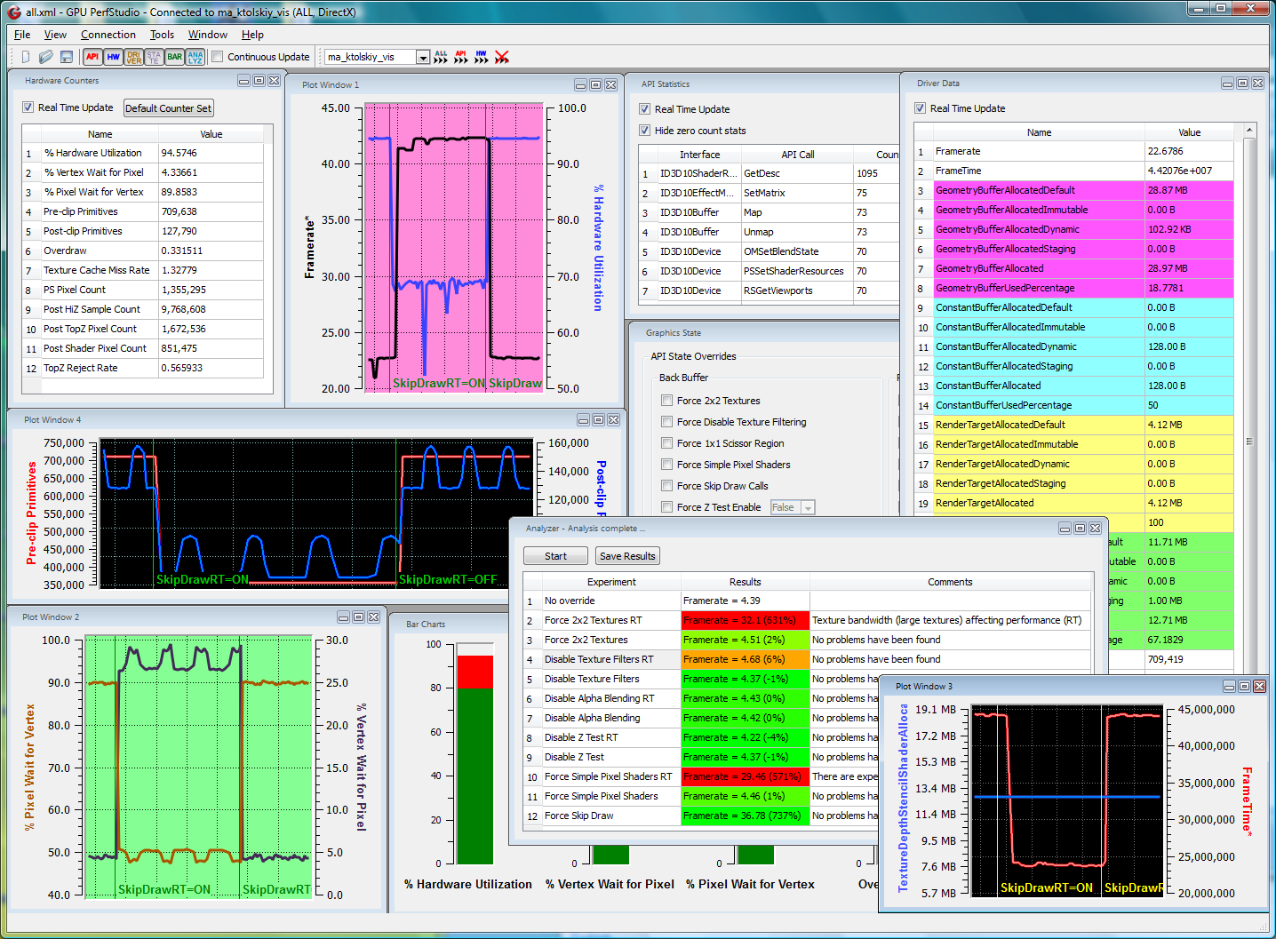
Notes:
GPUPerfStudio

Slide 20
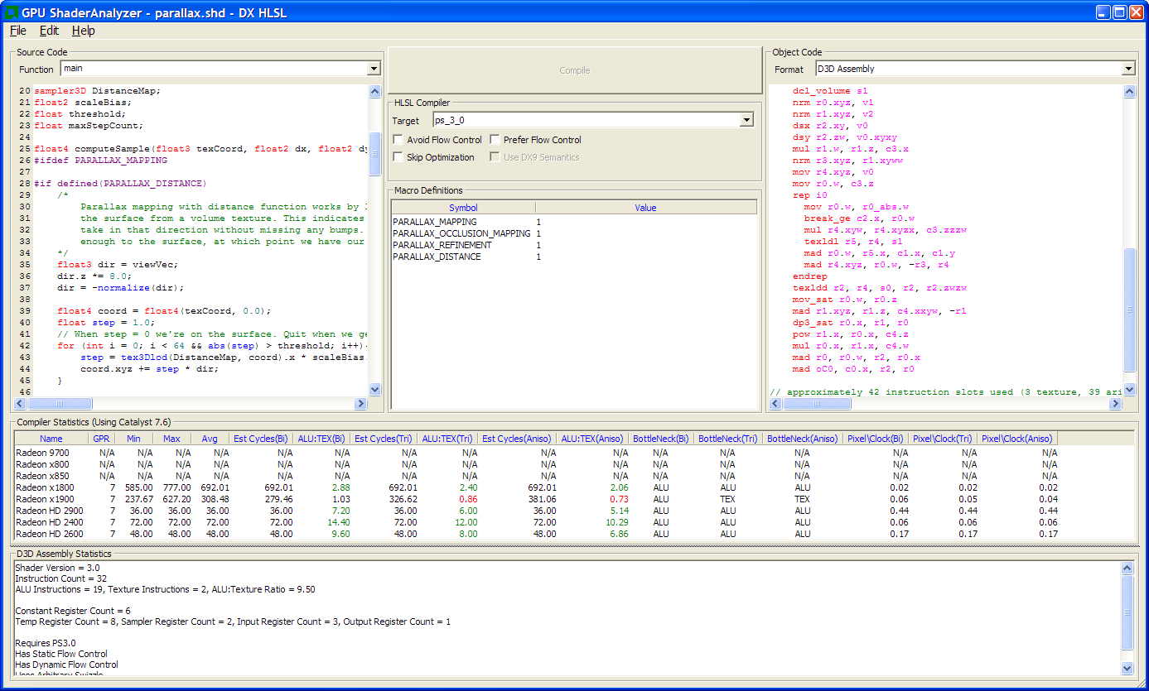
Notes:
GPU Shader Analyzer

Slide 21
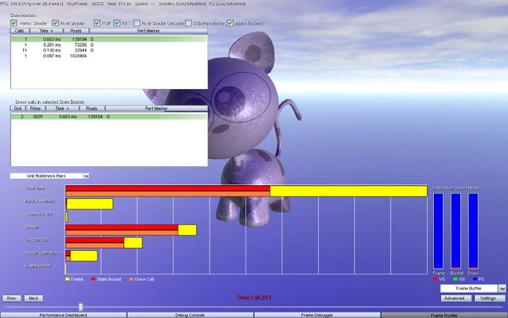
Notes:
NVDIA PerfHud Bottleneck detection

Slide 22
LOD/Mip-maps
Do less
Look better
‘nuff said?

Slide 23
Grass, Smoke, and Transparency
What you can’t see may hurt you
Alpha test means some shaded pixels that don’t occlude
Smoke/transparency means deep non-occluding layers

Slide 24
PIX for Fun and Profit
Understanding
Debugging
Mesh debugging
Shader debugging (bidirectional!)
Add annotations for ease of navigation
CDXUTPerfEventGenerator so they appear in Profile builds only

Slide 25
Shader Optimizations/Costs
Most instructions have no latency, one-cycle throughput
Instruction pairing can double performance
Scalar instructions (log, exp, rcp, rsq) cost more when applied to vectors
Macros (sincos) cost more
Non-coherent reads from constant memory can be expensive
Avoid doing math on constants
Read ATI and NVIDIA’s papers and presentations
Get ATI and NVIDIA to optimize your game for you
Reduce register usage
Notes:
Gamma correction with pow(diffuse, 2.2) silently expands to nine instructions!
Restricting it to xyz cuts the cost down to seven.
Implementing pow(diffuse, 2.0) as squaring cuts the cost down to one.
Using a table lookup in a texture cuts the cost down to three.
Using an sRGB render target can cut the cost to zero.

