Slide 1
UW Extension Certificate Program in Game Development 2nd quarter: Advanced Graphics
Introduction

Slide 2
About me
Juan Carlos Arevalo Baeza
Call me “JCAB”
Studies: Telecommunications Engineering
Experience: Audio, Graphics, Demos
Games: Force Commander, Fable, Counterstrike, Forza Motorsport, Chucks Ducks 2, Project Sunburst
Recently: Xbox 360 backwards compatibility, D3D for Xbox 360
Currently: Microsoft Games Studios mercenary
Contact: jcab@uw.thejcab.com

Slide 3
The course
We will cover a lot of ground
The hows and the whys
Class website:
http://uw.thejcab.com
These slides already available there
Bibliography: not required – it’s for reference
Feel free to write email with any questions/concerns

Slide 4
Homework
Homework will consist primarily on practical exercises related to the class
Due by Saturday morning, nine days after the class it was assigned
That way, you’ll have one class in which to ask questions before submitting
Many problems with completing homework caused by issues unrelated to the assignment
Be proactive asking for help
From me or from your fellow classmates over the email list
Sending something that doesn’t quite work is always better than sending something good late

Slide 5
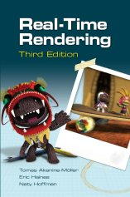
Bibliography
Real-Time Rendering (3rd Edition)
Thomas Akenine-Möller et al.
AK Peters, 2008
ISBN 978-1-56881-424-7
Pros: modern and very complete
Website: http://www.realtimerendering.com/
It’s full of links to good information

Slide 6
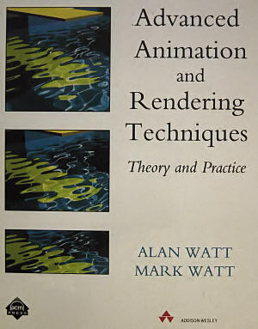
Bibliography
Advanced Animation and Rendering Techniques, Theory and Practice
Alan Watt, Mark Watt
ACM Press, Addison-Wesley, 1992
ISBN 0-201-54412-1
Pros: theoretical foundation, comprehensive
Especially about lighting models
Cons: old (15 years)
Some dated information, errors never corrected

Slide 7
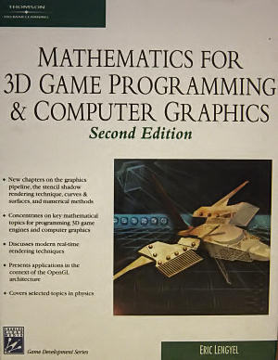
Bibliography
Mathematics for 3D Game Programming & Computer Graphics
Eric Lengyel
Charles River Media, 2004
ISBN 1-58450-277-0
Pros: excellent reference for math background
Including algorithms and code
Cons: daunting heavy math at times
Not for the faint of heart

Slide 8
Questions?

