Slide 1
UW Extension Certificate Program in Game Development 2nd quarter: Advanced Graphics
Particle systems

Slide 2
Goals
Understand the basic math of particle systems
Learn how to render them with sprites

Slide 3
Particle system math
Particles are driven by simple physics simulation
Often use just Euler integration
Data per-particle:
Position and velocity
Mass (often elided, all particles have the same)
Age (particles must die)
Visuals (color, texture, transparency)

Slide 4
Particle system simulation
Simplest way to implement them is iteratively:
for (each particle 'p')
{
Force = CalculateForce(p.Pos, p.Vel);
Accel = Force / p.Mass;
p.Pos += p.Vel;
p.Vel += Accel;
p.Age += 1;
}
Do for every particle, every frame

Slide 5
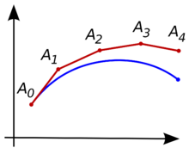
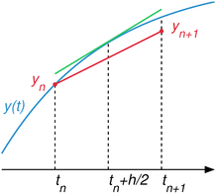
Integration strategies
Euler’s method isn’t very stable with non-trivial forces
A better method is midpoint integration
p.Pos += p.Vel + Accel/2;
p.Vel += Accel;
Can also use: Runge-Kutta
Must calculate the forces multiple times
More expensive
Euler
midpoint

Slide 6
Collisions
You may need particles to interact with geometry
The particle describes a path (straight line or not)
Intersection of line segment with geometry
Record the position and normal at the collision point
Then, there must be a reaction when colliding
Bounce back: V^{r} = V + 2*dot(V,N)*N (pure reflection)
Better method: calculate two segments, before/after
Beware of monsters: multiple collisions, twitching

Slide 7
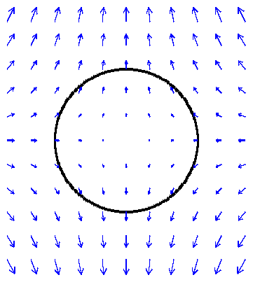
Force fields
Forces dependent on the position
Can be stored in 2D or 3D arrays of vectors
Like images or textures
Or calculated procedurally from position, using math
Wind, for instance, with whirlwinds and eddies

Slide 8
Rendering sprites
Z-facing shows less distortion
But other geometry doesn’t
O-facing is more expensive
Generally not worth it
Sprites are represented by:
Position (P) and size (S)
And attributes (color, opacity, texture coordinates…)
Z-facing
O-facing
S
S
P
P
Z
O

Slide 9
Rendering sprites (cont)
Must find the four corners of the quad
P +/– (S*X) +/– (S*Y)
X, Y are axis of view space, in world coordinates
X, Y are the first two columns of the view matrix
Y
S
S
P
X

Slide 10
Other sprite-like things
Groups of crisscrossed quads
Provide more volume
Axis sprites
Defined on two points
Faces the camera, pivoting on axis
Criscrossed beams
Two or more axis sprites, not facing the camera
Sharing same axis
Also provides volume
P₁
P₀
Axis sprite

